Slide 1

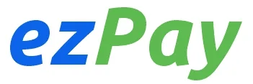
NatWest_TI_Graduates_FS_JAVA_Cloud_DevOPs_2
Squad - 04
EzPay
Use Case : Transaction Management
Notes:
Project Title Slide

Slide 2


Team Members
Nithya Bharadwaj P
Shivaji Reddy
Harshdeep Singh
Navin Yadav
Preethi R
Notes:
Team Members Details

Slide 3
PRESENTATION FLOW :
Introduction - Overview of the EzPay application
Objectives - Goals and purpose of the project
Technical Requirements - Technologies used for development and testing
Architecture Diagram - System architecture and design structure
E-R Diagram - Entity-Relationship diagram for database structure
Class Diagram - Overview of the classes and relationships in the system
Tables Used - Details of database tables utilized
Use Case Diagram - Depiction of user interactions with the system
Functionalities - Key features and capabilities of the application
Methodology & Timeline - Development process and project timeline
Conclusion - Final summary of the project
LIVE DEMONSTRATION OF THE EZPAY APPLICATION
QUESTIONS AND FEEDBACK
Notes:
You can add any number of rows here in this table to fill all topic names for respective deck topics

Slide 4
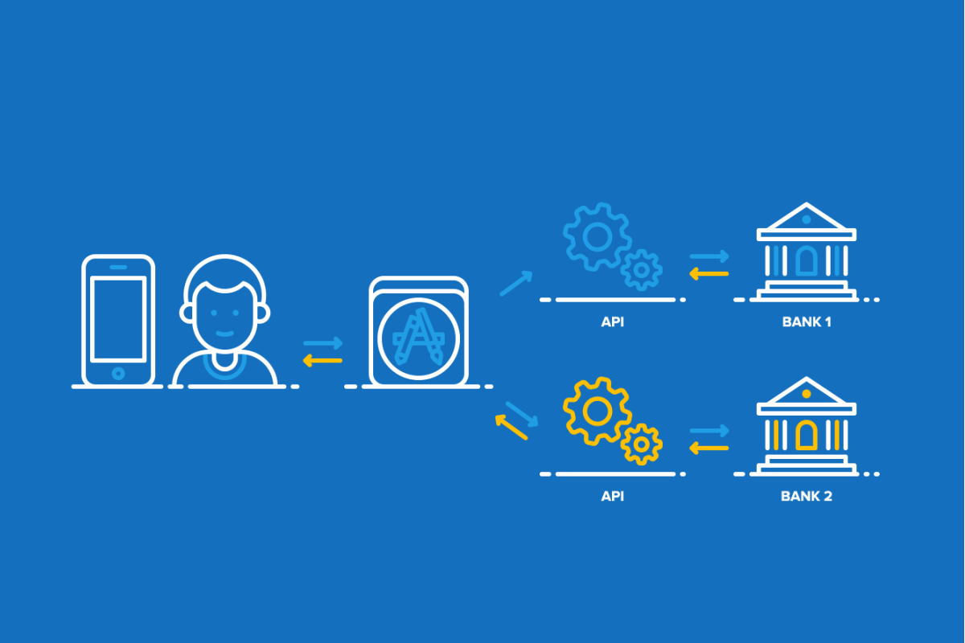
Introduction
EZPay (Bank Transactions Management)
Introduction
Objectives
Technical Requirement
ER Diagram
Class Diagram
Use Case Diagram
Functionalities
Timeline
Conclusion
A full stack application, developed to manage the transactions of a user.
The main intent of this project is to ease the work by adding all the functionalities to be done with transactions.
This application maintains the information about the transactions and allows to view and schedule it.
Notes:
Content Slide with Side bar, content and Image

Slide 5
Objectives
Objectives
Introduction
Objectives
Technical Requirement
ER Diagram
Class Diagram
Use Case Diagram
Functionalities
Timeline
Conclusion
Provide a clear and accessible interface for users to view and filter their transaction history.
Implement intuitive navigation and filtering options (date range, type, status) to improve usability.
Allow users to cancel or modify scheduled payments efficiently, ensuring a seamless user experience.
Ensure all scheduled payment data is retrieved and updated in real-time for user convenience.
Implement informative messages for scenarios where no transactions exist or transaction status cannot be retrieved.
Notes:
Slide with objectives

Slide 6












Technical Requirement
FRONTEND TECHNOLOGIES AND OTHER SOFTWARES USED
Introduction
Objectives
Technical Requirement
ER Diagram
Class Diagram
Use Case Diagram
Functionalities
Timeline
Conclusion
Testing :
Jest
Development :
HTML
CSS
Bootstrap
JavaScript
React
Node.js
Integrated Development Environment:
VsCode
Eclipse
SpringToolSuite
Version Control :
GitLab
Notes:
Content Slide with Side bar, content and Image

Slide 7








Technical Requirement
BACKEND TECHNOLOGIES USED
Introduction
Objectives
Technical Requirement
ER Diagram
Class Diagram
Use Case Diagram
Functionalities
Timeline
Conclusion
Development :
Java
Springboot
Spring JPA
Database :
Oracle SQL
Testing :
Postman
JUnit
Mockito
Notes:
Content Slide with Side bar, content and Image

Slide 8
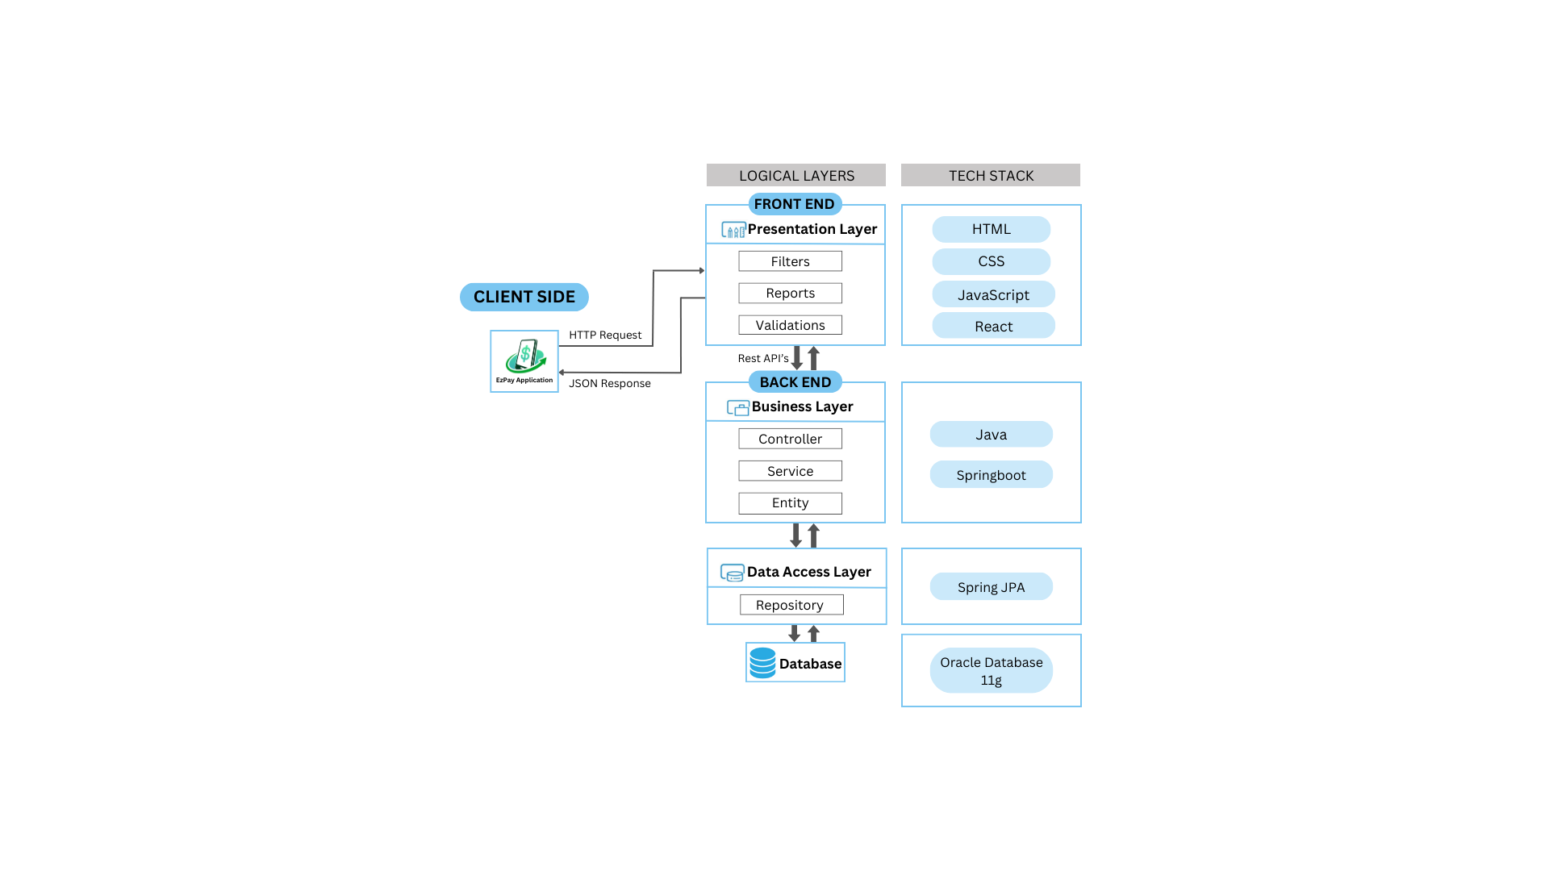
SpringBoot+React Full Stack Application Architecture
Introduction
Objectives
Technical Requirement
ER Diagram
Class Diagram
Use Case Diagram
Functionalities
Timeline
Conclusion
Notes:
Content Slide with Side bar, content and Image

Slide 9
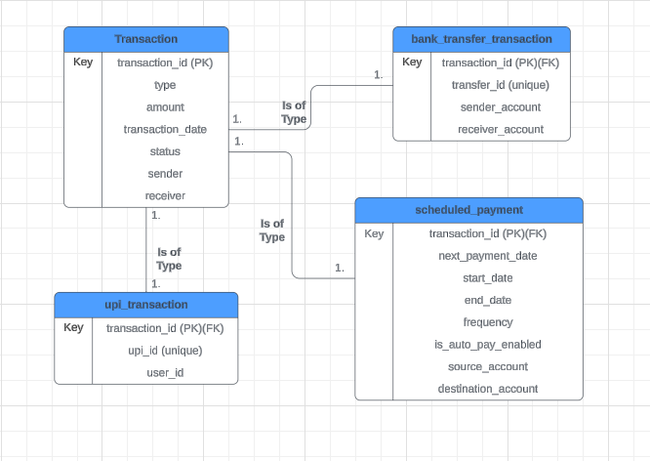
E-R Diagram
Introduction
Objectives
Technical Requirement
ER Diagram
Class Diagram
Use Case Diagram
Functionalities
Timeline
Conclusion
Notes:
Content Slide with Side bar, content and Image

Slide 10
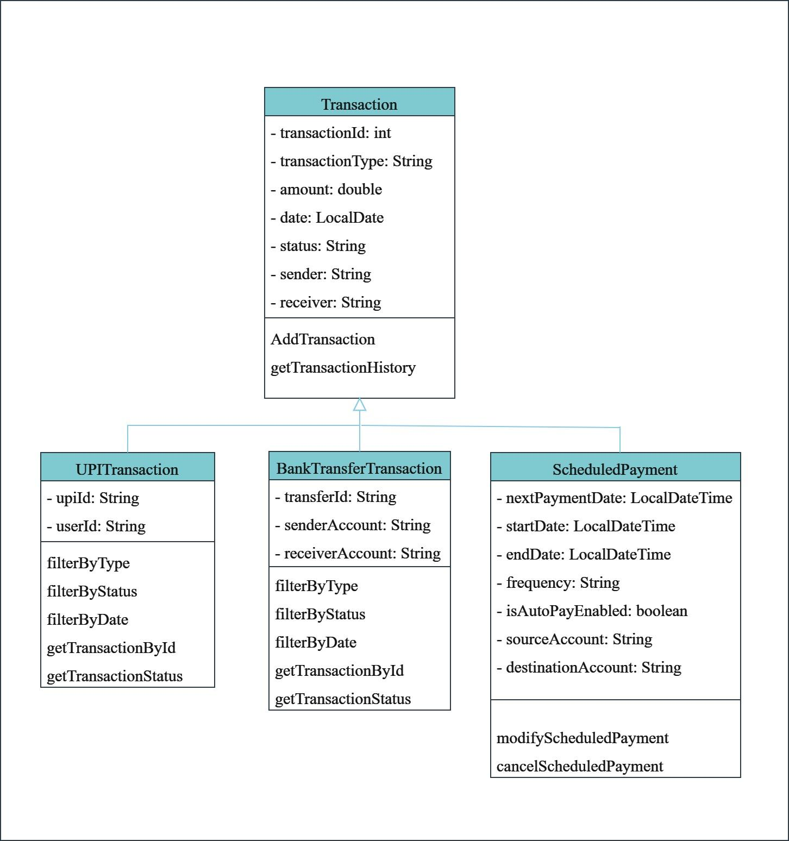
Class Diagram
Introduction
Objectives
Technical Requirement
ER Diagram
Class Diagram
Use Case Diagram
Functionalities
Timeline
Conclusion
Notes:
Content Slide with Side bar, content and Image

Slide 11
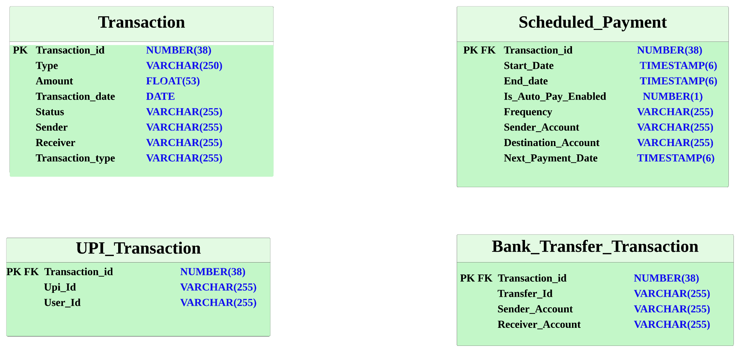
Total Tables Used
Introduction
Objectives
Technical Requirement
ER Diagram
Class Diagram
Use Case Diagram
Functionalities
Timeline
Conclusion
Notes:
Content Slide with Side bar, content and Image

Slide 12
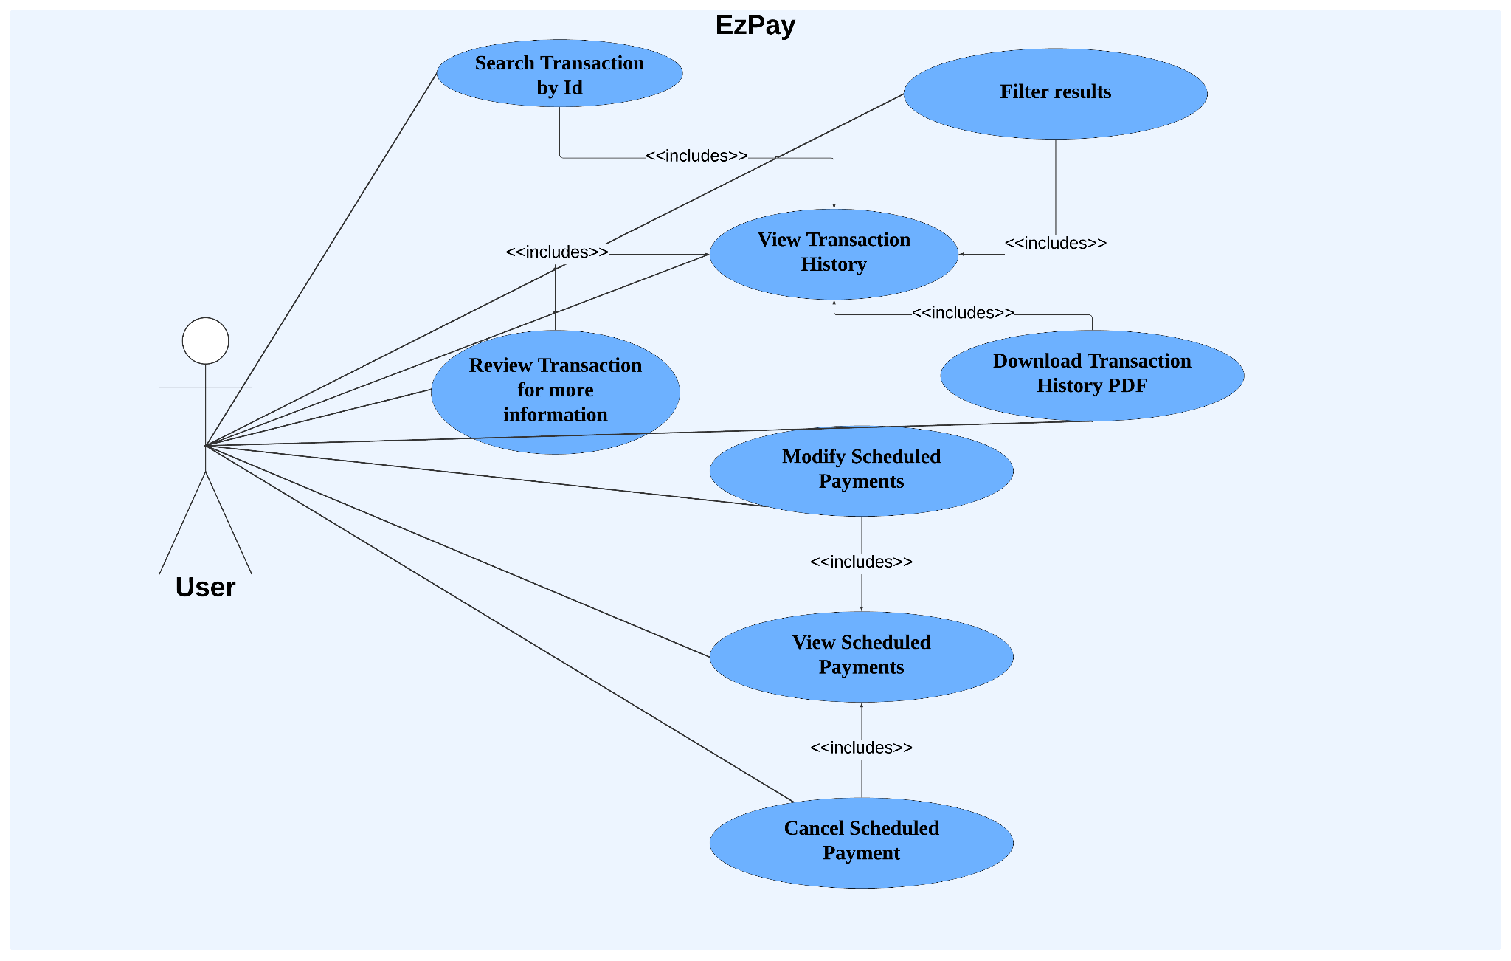
Use Case Diagram
Introduction
Objectives
Technical Requirement
ER Diagram
Class Diagram
Use Case Diagram
Functionalities
Timeline
Conclusion
Notes:
Content Slide with Side bar, content and Image

Slide 13
Functionalities
Introduction
Objectives
Technical Requirement
ER Diagram
Class Diagram
Use Case Diagram
Functionalities
Timeline
Conclusion
Transaction
History
Display all Transaction
Search by ID
Review Transaction
Download Transactions
Filtering Transactions
Filter by Type
Filter by Status
Filter by Date
Schedule Payments
View scheduled payments
Modify scheduled payments
Cancel scheduled payments
Notes:
Content Slide with Side bar, content and Image

Slide 14
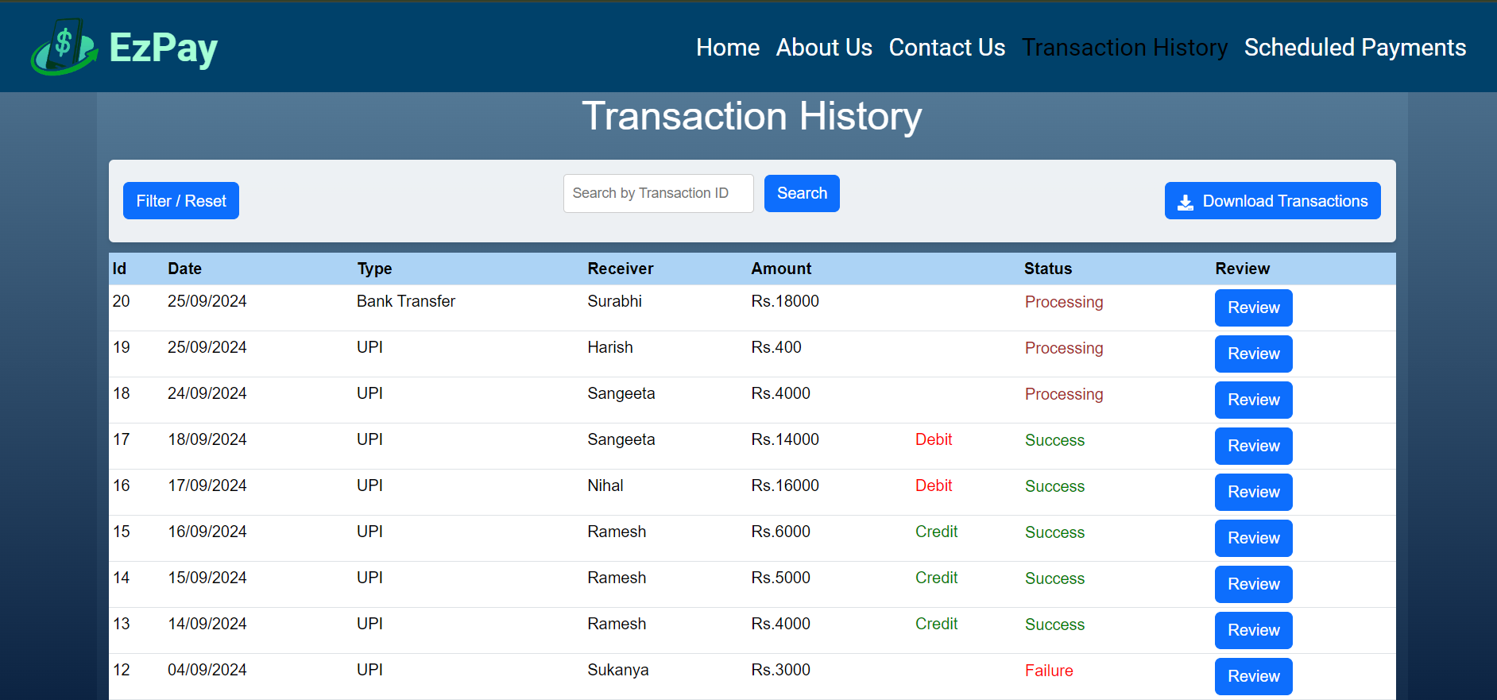
Transaction History
Introduction
Objectives
Technical Requirement
ER Diagram
Class Diagram
Use Case Diagram
Functionalities
Timeline
Conclusion
In this functionality the user can view all the transactions.
Notes:
Content Slide with Side bar, content and Image

Slide 15
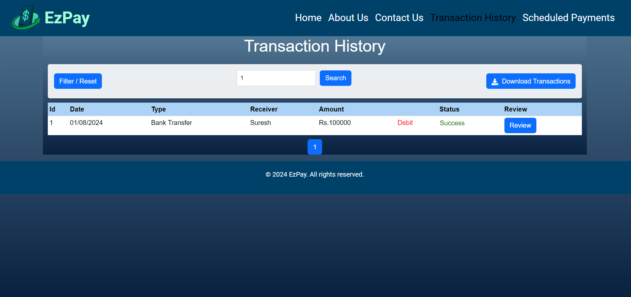
Transaction History
Introduction
Objectives
Technical Requirement
ER Diagram
Class Diagram
Use Case Diagram
Functionalities
Timeline
Conclusion
In this functionality the user can search a particular transaction by entering the ID.
Notes:
Content Slide with Side bar, content and Image

Slide 16
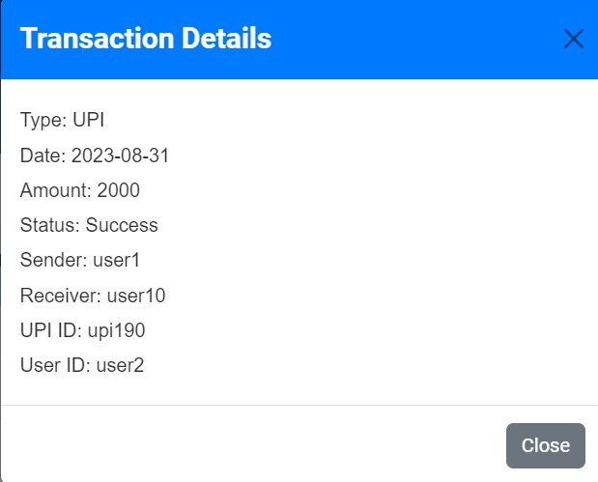
Transaction History
Introduction
Objectives
Technical Requirement
ER Diagram
Class Diagram
Use Case Diagram
Functionalities
Timeline
Conclusion
In this functionality the user can review a particular transaction and get additional information about the transaction.
Notes:
Content Slide with Side bar, content and Image

Slide 17
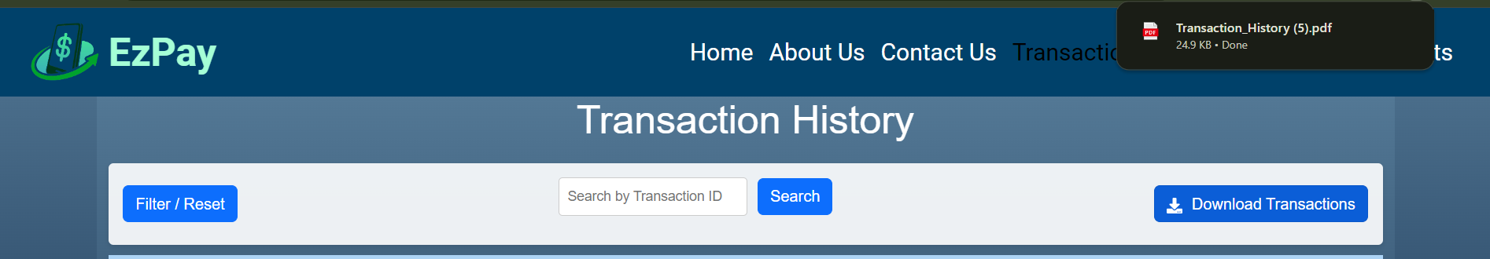
Transaction History
Introduction
Objectives
Technical Requirement
ER Diagram
Class Diagram
Use Case Diagram
Functionalities
Timeline
Conclusion
In this functionality the user can download the transactions in .pdf format.
Notes:
Content Slide with Side bar, content and Image

Slide 18
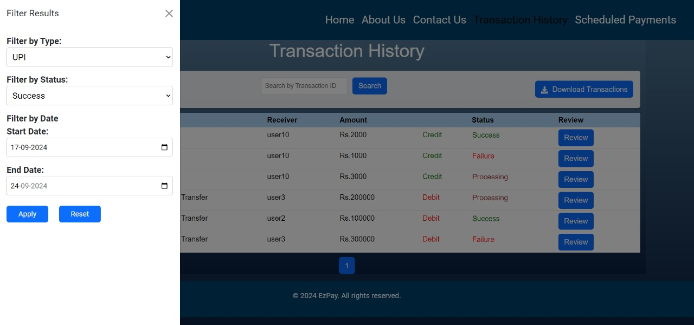
Filtering Transactions
Introduction
Objectives
Technical Requirement
ER Diagram
Class Diagram
Use Case Diagram
Functionalities
Timeline
Conclusion
In this functionality the user can filter the transactions on the basis of:
Type - UPI, Bank Transfer.
Status - Success, Failure, Processing.
Date - Transactions in between the dates.
Notes:
Content Slide with Side bar, content and Image

Slide 19
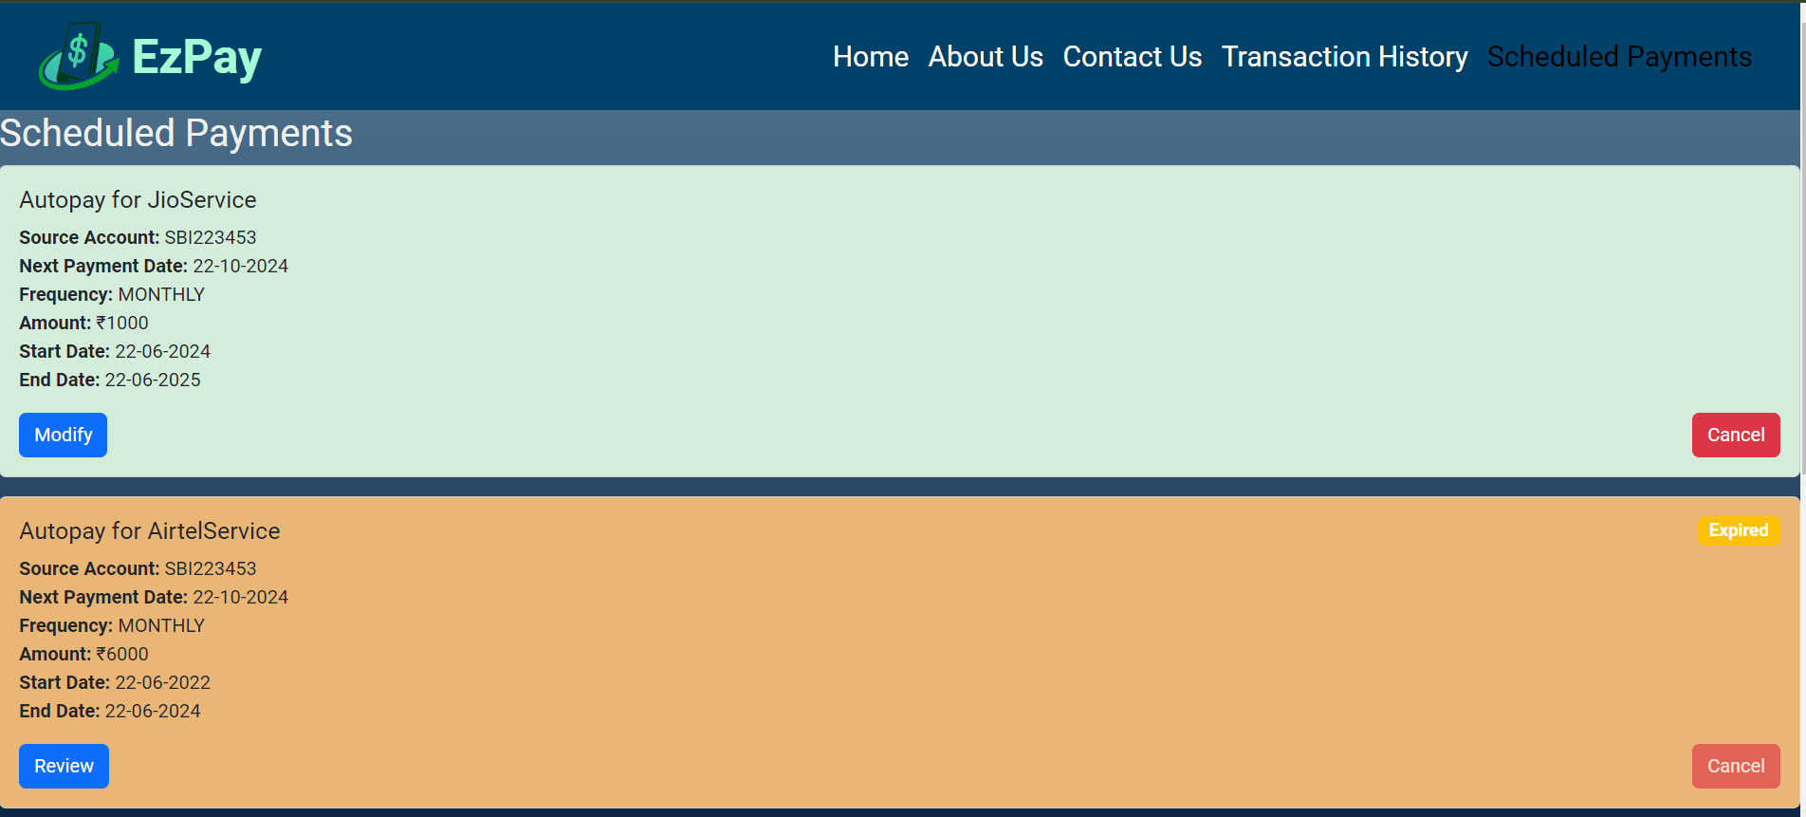
Schedule Payments
Introduction
Objectives
Technical Requirement
ER Diagram
Class Diagram
Use Case Diagram
Functionalities
Timeline
Conclusion
In this functionality the user can see all the scheduled payments.
Notes:
Content Slide with Side bar, content and Image

Slide 20
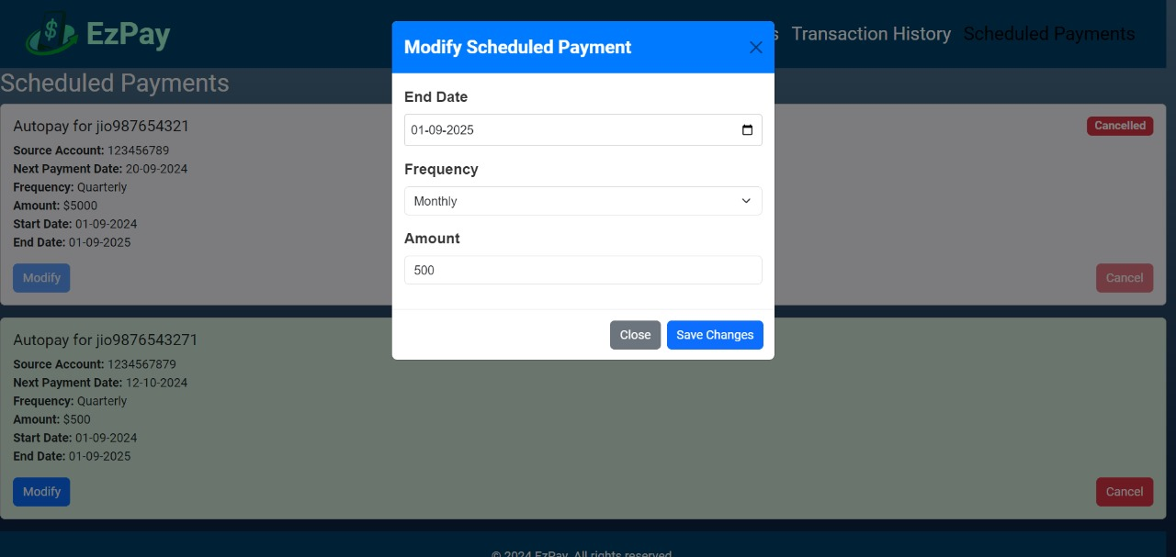
Schedule Payments
Introduction
Objectives
Technical Requirement
ER Diagram
Class Diagram
Use Case Diagram
Functionalities
Timeline
Conclusion
In this functionality the user can modify the scheduled payments by adjusting the date, frequency and the amount.
Notes:
Content Slide with Side bar, content and Image

Slide 21
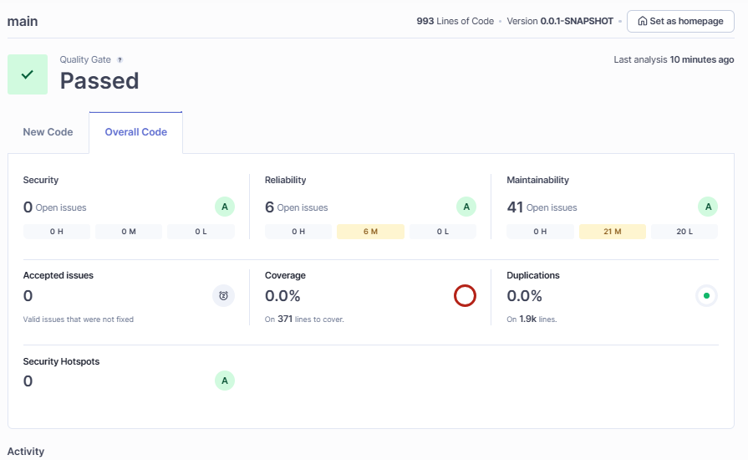
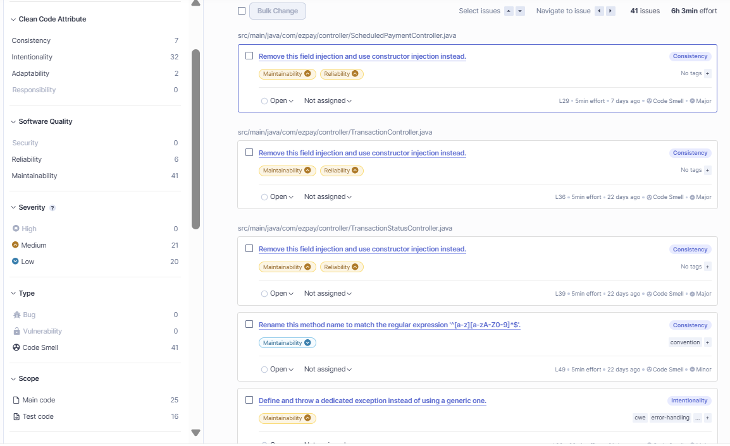
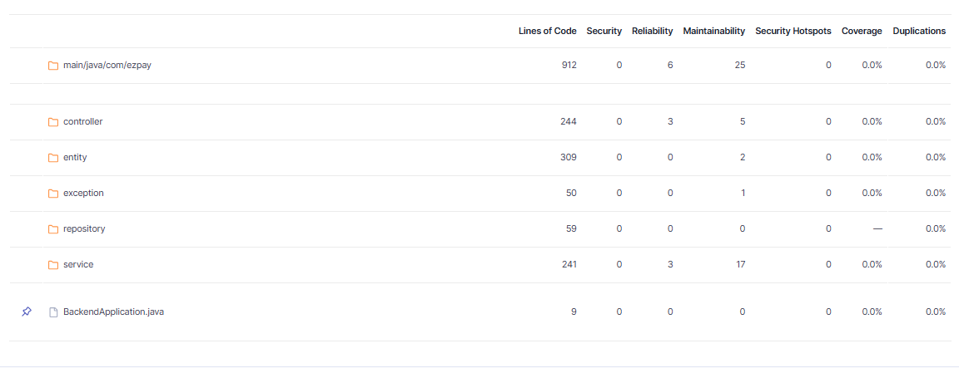
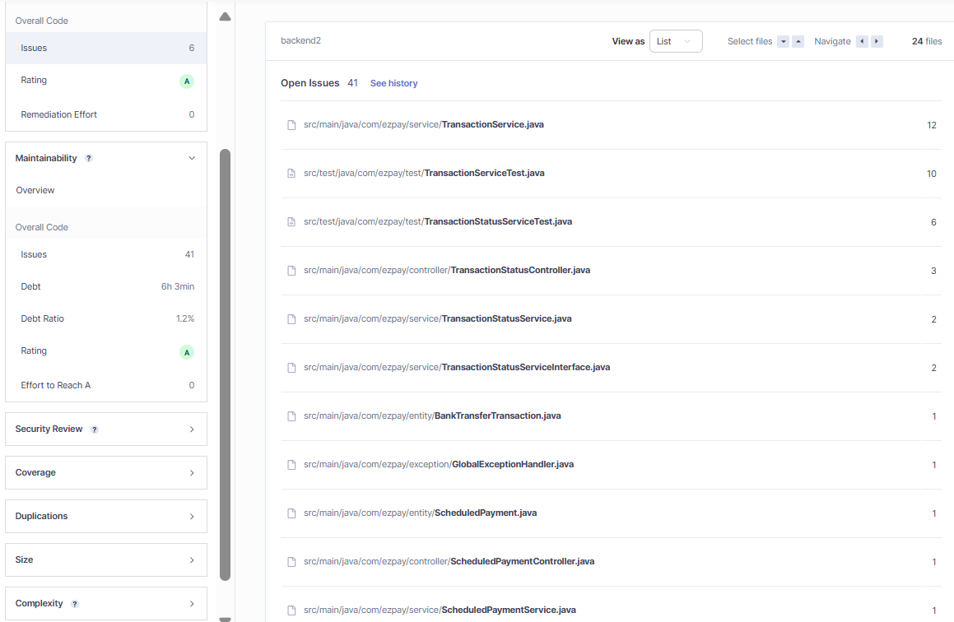
SonarQube Analysis on Backend Code
Introduction
Objectives
Technical Requirement
ER Diagram
Class Diagram
Use Case Diagram
Functionalities
Timeline
Conclusion

Slide 22
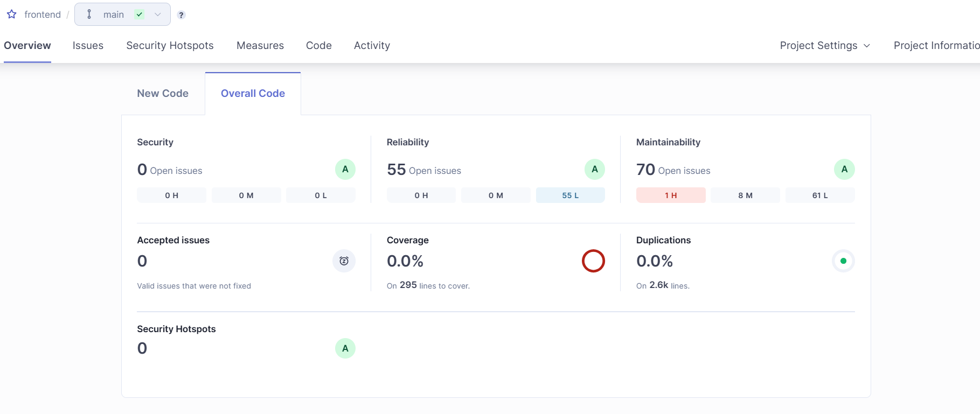
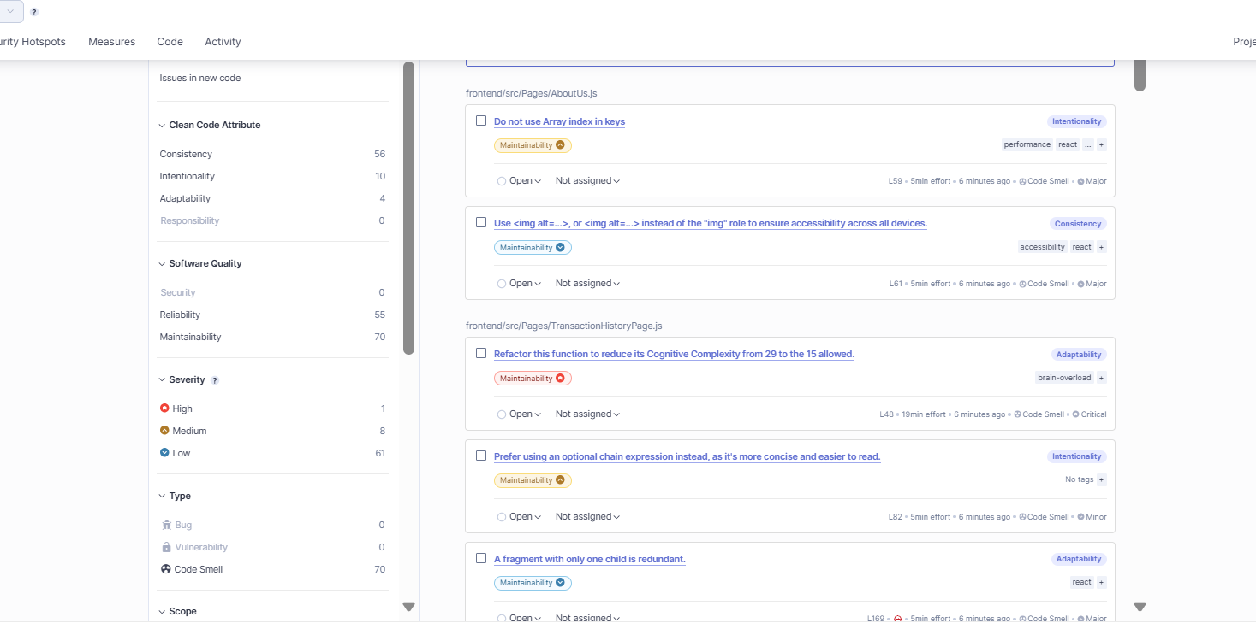
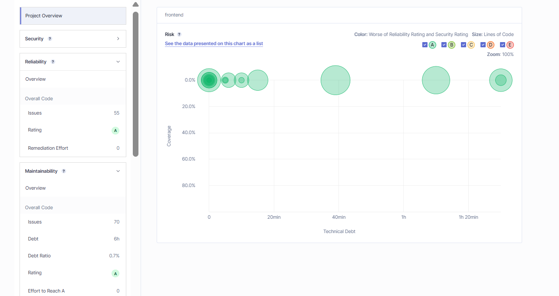
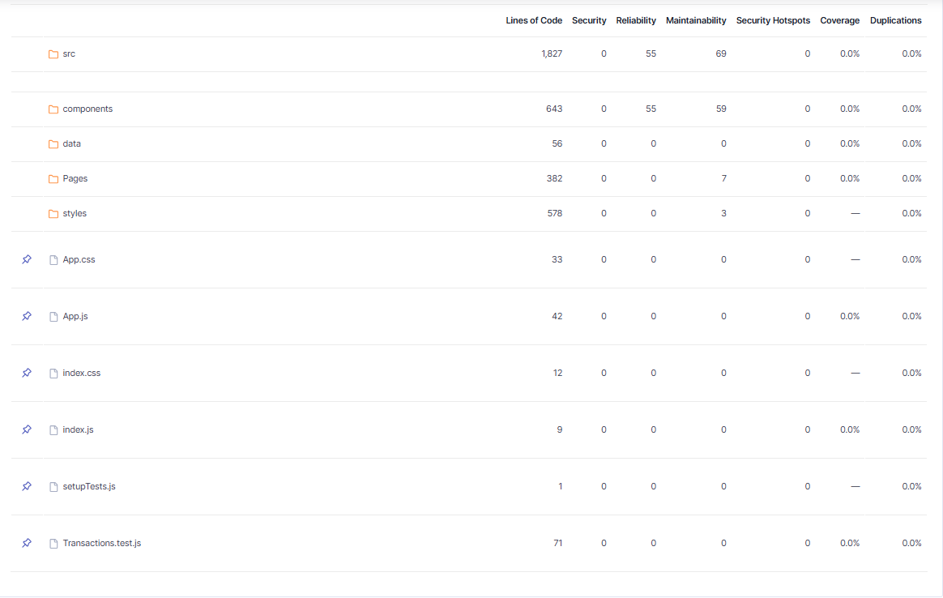
SonarQube Analysis on Frontend Code
Introduction
Objectives
Technical Requirement
ER Diagram
Class Diagram
Use Case Diagram
Functionalities
Timeline
Conclusion

Slide 23
Timeline
Sprint 1
8th AUG 2024
Introduction
Objectives
Technical Requirement
ER Diagram
Class Diagram
Use Case Diagram
Functionalities
Timeline
Conclusion
Simple Java Application
Sample Data Preparation
Filtration Logic
Transaction Search logic
Developers: Harsh,Shivaji
Testers: Nithya, Preeti
Code Reviewer: Navin
Sprint 2
20th AUG 2024
Developers: Nithya, Preeti
Testers: Harsh, Navin
Code Reviewer: Shivaji
MVC layer implementation
Database Connectivity using jdbc
Sprint 3
6th SEP 2024
Implementing front end in react
Implementing back end in spring boot
Database connectivity
Frontend
Developers: ALL
Testers: Navin
Code Reviewer: Navin
Backend
Developers: Harsh,Shivaji
Testers: Nithya, Preeti
Code Reviewer: Navin
Notes:
Content Slide with Side bar, content and Image

Slide 24
Conclusion
The transaction module project delivers a comprehensive solution for managing transactions.
Frontend:
Developed with React for a user-friendly experience.
Allows users to easily view, manage, and modify transactions.
Allows users to filter transactions on various parameters.
Backend:
Built using Springboot and JPA for robust data handling..
The project is designed to meet current requirements while allowing for future enhancements, such as:
Advanced analytics.
Real-time notifications.
Overall, the system empowers users with tools that simplify transaction management, contributing to better decision-making and operational efficiency.
Introduction
Objectives
Technical Requirement
ER Diagram
Class Diagram
Use Case Diagram
Functionalities
Timeline
Conclusion
Notes:
Content Slide with Side bar, content and Image

Slide 25

Any Questions ?

Slide 26

Thank You.

